Slide 1


Investigating the dynamic patterns of management costs in protected areas
Informing more effective investments in land conservation
Diane LE BOUILLE
dlebouille@utk.edu
University of
Tennessee

Slide 2
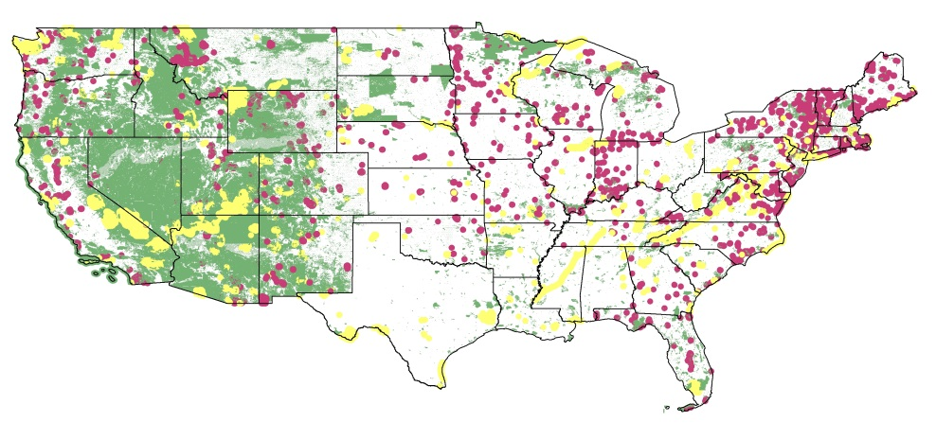
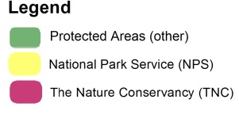
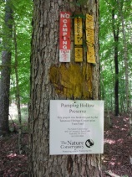
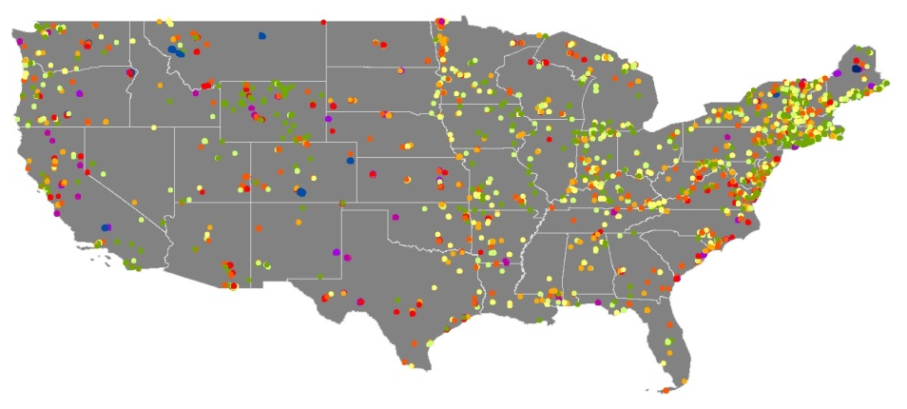
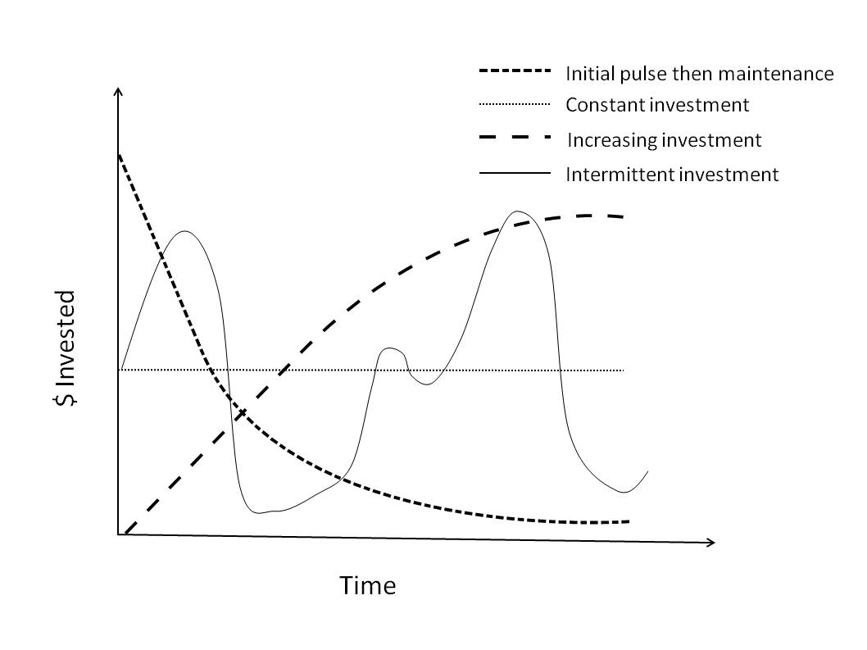
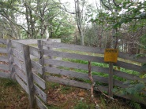
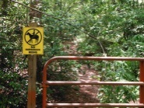

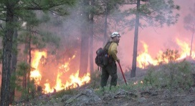
Intro
Protected areas
and The Nature Conservancy
Conservation costs
Acquisition costs
Management costs
Notes:
Actually 13%, Nagoya protocol from the Convention on Biological Diversity aim at >17% by 2020
One time: acquisition and recurrent costs: stewardship (overhead and management)

Slide 3
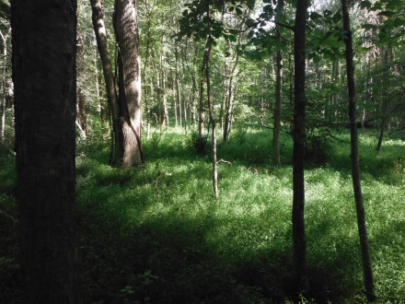
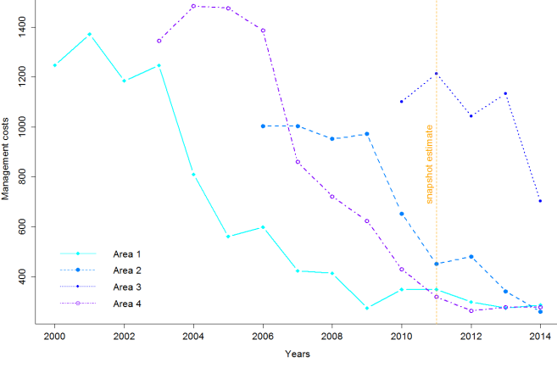
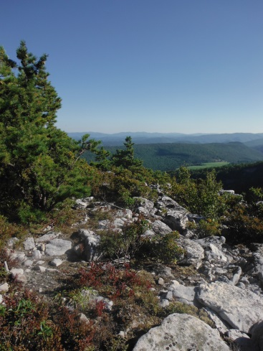
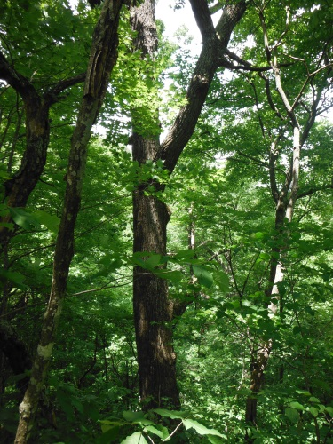
Management costs
Often left out of spatial optimization…
Spatial variation
Temporal variation
conservation goals and needs
… and why it matters
Notes:
Outweight acquisition costs over time and become main drivers
Rare studies who do cares it varies in both direction-> snapshot = +++ constrained

Slide 4
Questions
How do investments in site management change through time and in association with site characteristics?
How wrong are we when we disregard this temporal variability?
How do costs and their patterns compare to resulting ecological benefits?

Slide 5
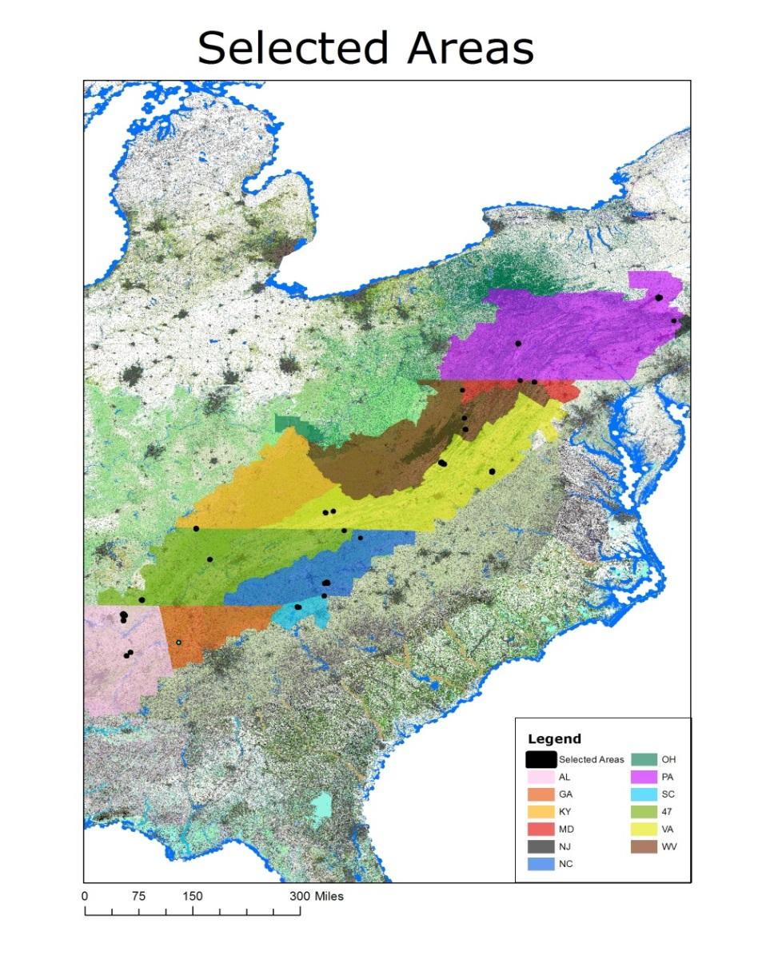
Methods
42 protected areas
South. and Central Apps
Acquired and maintained by TNC since 2000
Survey -> TNC land managers
Independent variables:
Time since protection
Area size
Protected area density
Urban Areas density
Road density
Agricultural land density
Easement density
Fire management
Notes:
They span 10 states and range in size from 1.5ha to 570ha and in acquisition price from 100% donation to more than $6 million.
Survey: staff time / spendings / trips -> cpi correct, etc… (NB: log = incr in dep variable is not just pdct of multiplicative error structure)

Slide 6
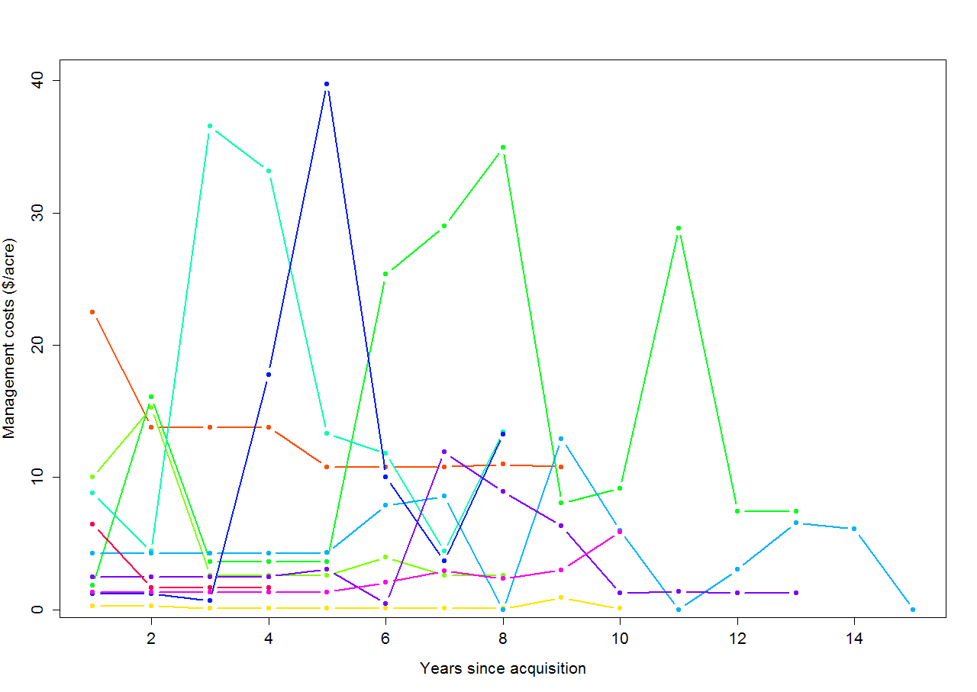
Investment Pattern

Slide 7
Explaining the variation
Building a regression model in time
No time :
Costs = α + β₁*Size+ β₂*Fire+ β₃*Agri+ β₄*Easements + β₅*PAs + β₆*Roads + β₅*UrbanAreas + ε
Variable | Estimate | P-value
Size (ha) | 0.004256 | **
Fire Management (yes or no) | 1.30697 | *
Agricultural lands (prop) | -2.3839
Easements (prop) | 1.61833
Protected Areas (prop) | 0.011065
Road Density (density) | 0.552102 | ***
Urban Area (prop) | -0.4201 | *

Slide 8
So does time matter?
Same time effect across sites
management costs =
α + β₁*predictor₁ + … + β_{n}*predictor_{n} + [ a + b*(time since protection)]+ ε
Time x characteristics
management costs =
α + β₁*predictor₁ + … + β_{n}*predictor_{n} + [ a₁ + a₂(predictor_{i})](time since protection)+ ε

Slide 9

Thanks!
To the Armsworth lab:
To The Nature Conservancy
Paul Armsworth
Benjamin Crain
Christine Dumoulin
Rachel Fovargue
Gwen Iacona
Heather Jackson
All the state chapter managers, who answered my many questions:
TNC head office staff, who provided protected area data:
Melissa Clark Joe Fargione Thomas Minney
Patrick McKenzie
Austin Milt
Ana Reboredo Segovia
Chad Stachowiak
Nate Sutton
Chuck Byrd
Malcolm Hodges
Chris Minor
Deborah Barber
Megan Sutton
Elizabeth Johnson
Corey Giles
Kristen Austin
Marek Smith
Sam Lindblom
Braven Beaty
Mike Powell

